Slide 1
Mechanical Trainings
MVRT 115 2016 - 2017

Slide 2
Safety Comes First
You
Tools/Machines
Your Projects
Your tools and your projects are replaceable. You are not.
If you are in a dangerous situation, your project is your lowest priority. As long as you and your tools are safe, anything that you are working on can always be made again. Make sure you are safe first, then worry about your project.

Slide 3

Safety With Tools
Wear safety glasses whenever you are in the vicinity of power tools
Additional personal protective equipment (PPE) may be necessary for certain tasks
Never work alone
Always make sure there is a mentor or veteran around you in case there is an emergency
Safe operation of certain power tools requires additional training
Check with a mentor or veteran to see if you are cleared to use the power tools you need
Keep fingers and hands away from dangerous situations
Guards and shields must be in place prior to operating equipment
Hold your workpiece with a clamp or vise when drilling
Keep fingers away from blade when using saws
Never leave a machine running unattended
Long hair must be tied back securely at all times

Slide 4

Prohibited Items
Loose clothing
Ties
Scarves
Skirts
Jewelry
Rings
Necklaces
Bracelets
Open-toed shoes
Headphones

Slide 5

Use Your Common Sense
Do not block walkways
Do not run, especially not around sharp tools
Do not climb on anything unstable, such as carts or robots
Do not eat or drink in work areas
Do not use compressed air to clean skin or clothing
Do not use broken or damaged equipment
Immediately report any hazardous situations, injuries, or problems with equipment to a mentor or veteran

Slide 6
Facilities - Deeksha
Woodshop:
Nothing leaves the shop.
Leave it as you find it.
P5:
Be aware of your workspace.
Vacuum wood/metal shavings promptly.
Return tools immediately after work.

Slide 7
Measurement Procedure
Use appropriate tools to mark material.
Metal: Dykem and scribe, NOT sharpie
Wood: Pencil
For fine measurements, use calipers.
Remember: Measure twice, cut once.

Slide 8
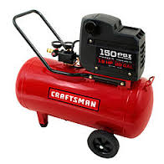
Machinery - Gautham, Nidhin, Deeksha
Compressor: → Deeksha
Plug in and pressurize.
Choose the right riveter head and the rivets of appropriate length.
Riveting process:
Insert riveter into riveter tail.
Insert rivet into hole.
Press down firmly and depress handle.
Do not let go of handle until riveter is off the surface.
Repeat, if necessary.
Wait for the riveter to fall out.

Slide 9
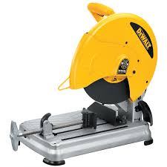
Machinery (Cont..)
Chop Saw: → Deeksha
Unplug before aligning with material.
Warn team members in nearby workspace.
After cutting, release throttle and allow saw blade to come to a complete stop before raising it up.

Slide 10
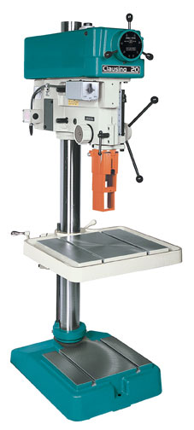
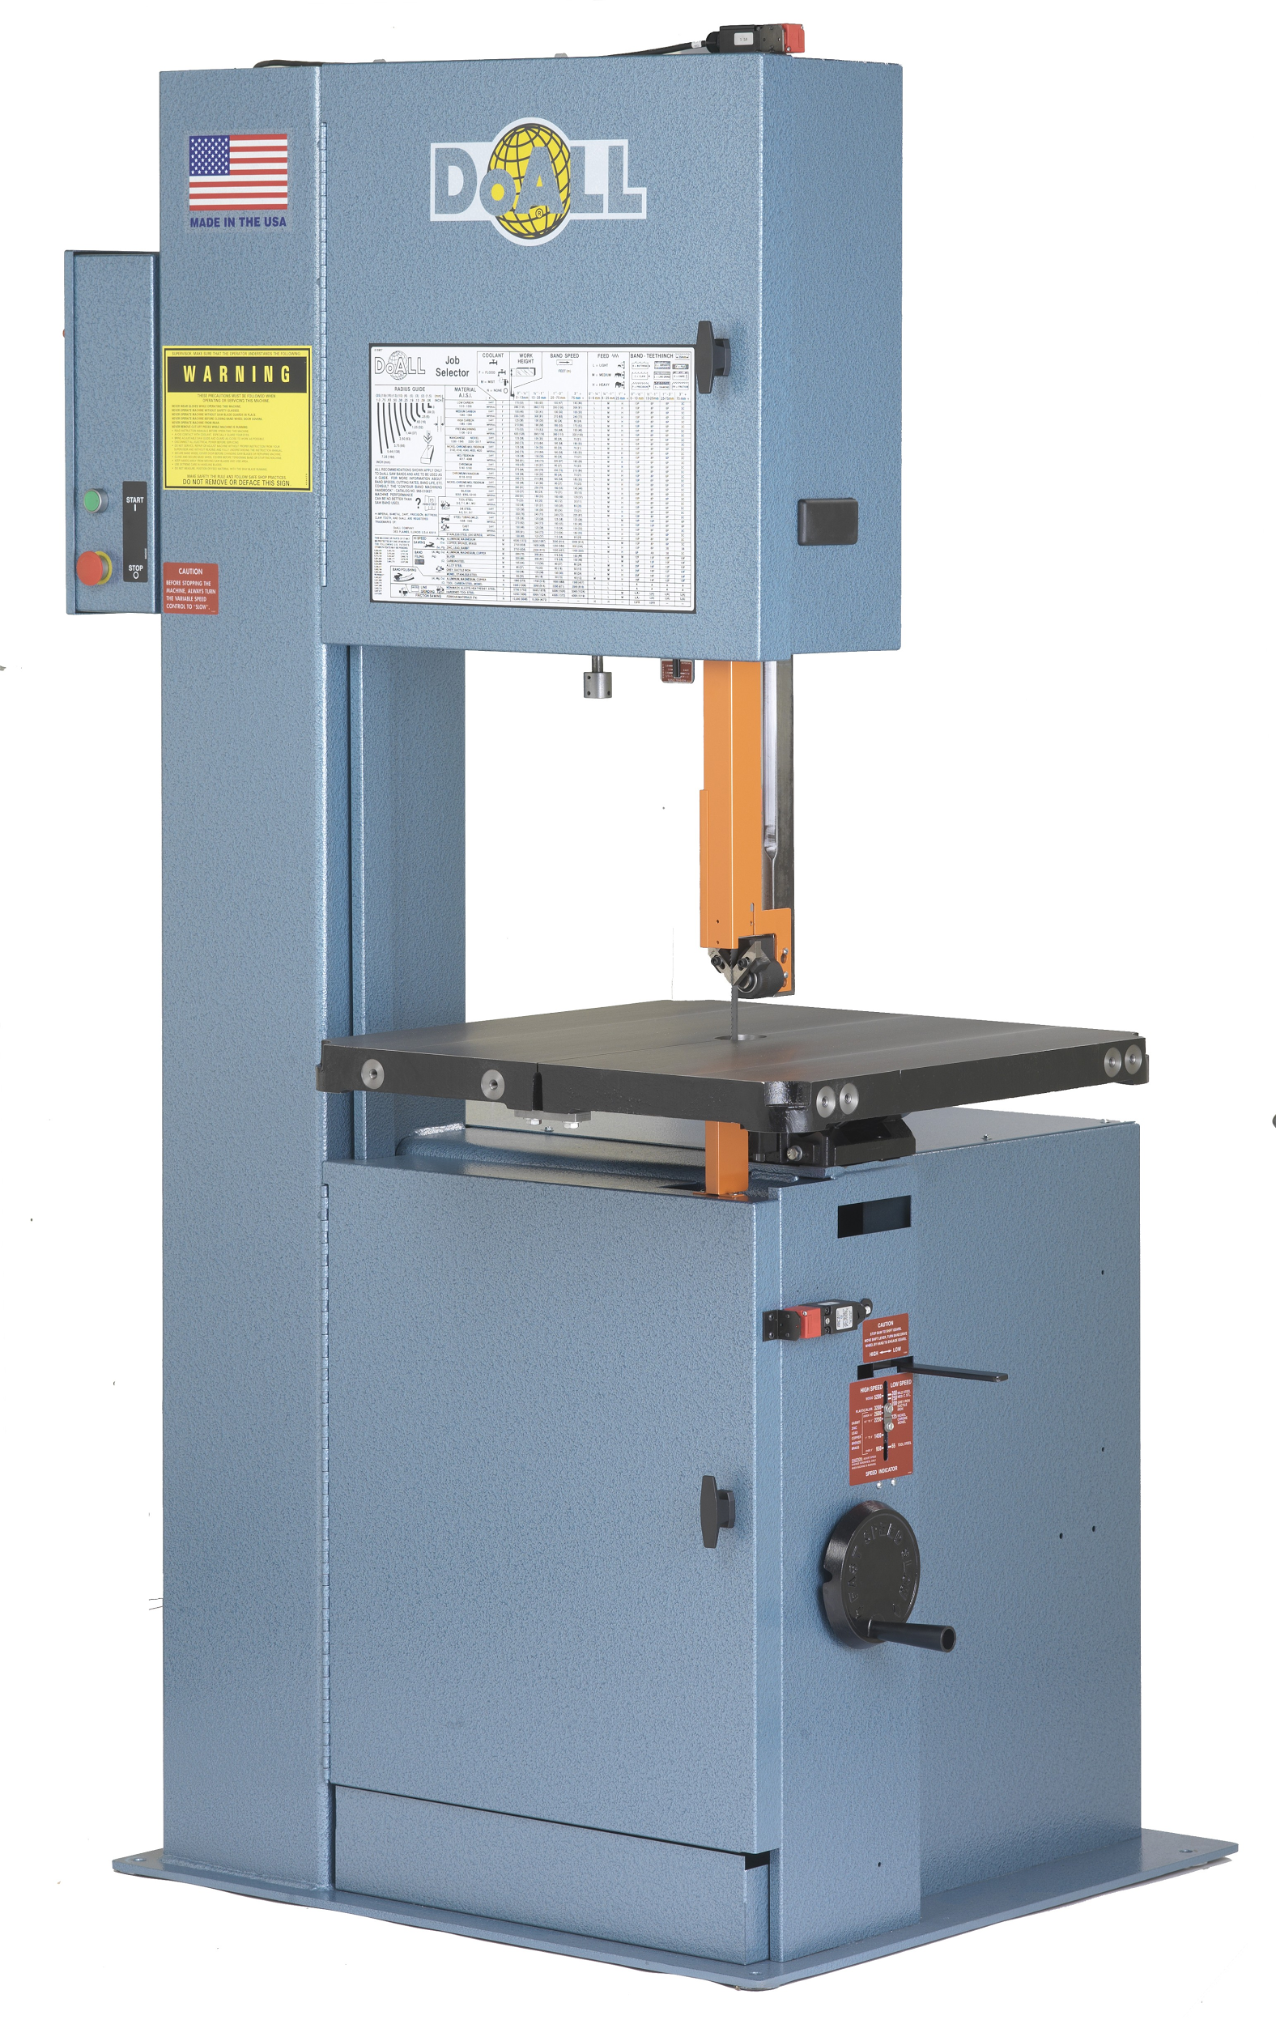
Machinery (Cont..)
Drill Press → Gautham
Make sure to clamp material before drilling.
Never leave the chuck key in chuck
After using a drill bit, take bit out of drill and return it
Do not leave excess material at the drill press
Bandsaw → Gautham
Know which side of markings to cut on
Adjust the guard
Alignment
Cleaning procedure

Slide 11
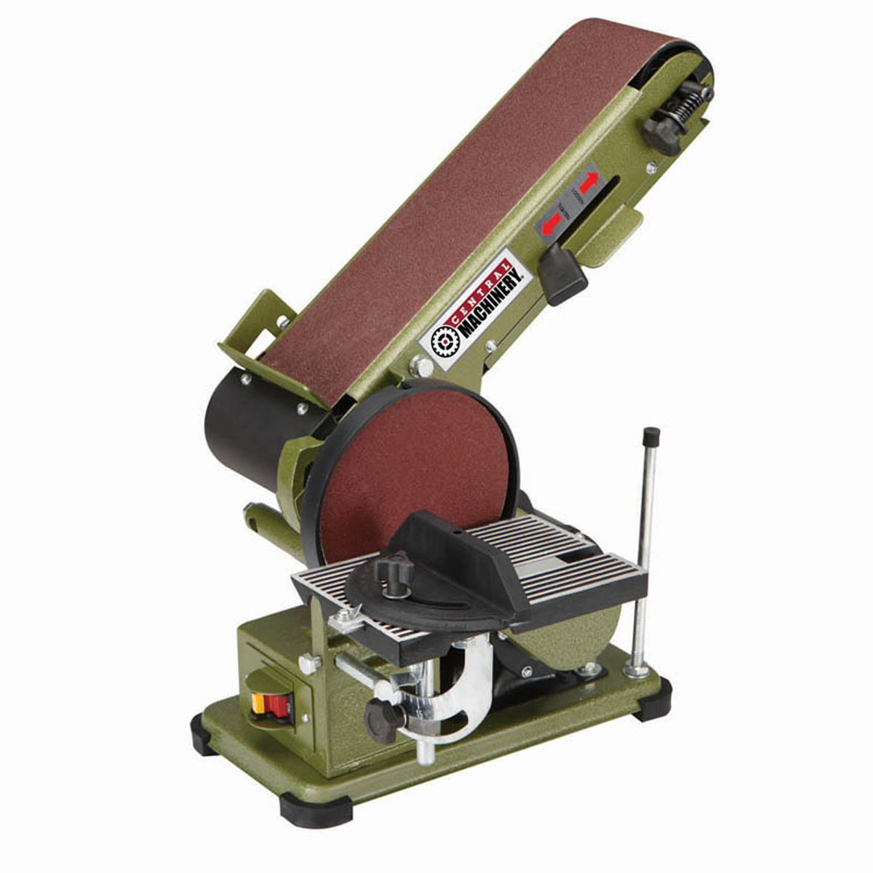
Machinery (Cont..)
Disc & Belt Sander → Gautham
Start the sander with a flick of the fingers
Use the left part of the disc to sand, as the right part will smack the part right back in your face

Slide 12

Machinery (Cont.)
Hand Drill →Nidhin
Clamp material if possible
Be aware of what direction the drill bit is turning
Turn clockwise if drilling into material; anti-clockwise if drilling out
Return drill bit after use
If drilling around electronics, cover the electronics with a blanket or have a vacuum running

Slide 13

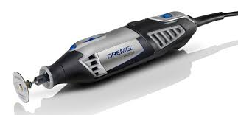
Jigsaw → Nidhin
A MENTOR OR VETERAN MUST BE SUPERVISING YOU!
Useful for cutting large boards of wood, or sheets of aluminum
Use dykem and scribe to outline what you are cutting
Dremel → Nidhin
Once again: SUPERVISION REQUIRED
Use two hands while dremeling
Commonly used to slightly adjust a materials dimensions or shape
Blade should be spinning away from you
Cover electronics if dremeling around them
Tidy up and put the dremel away in the dremel box

Slide 14
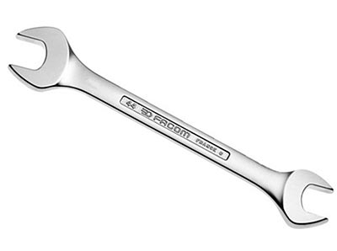
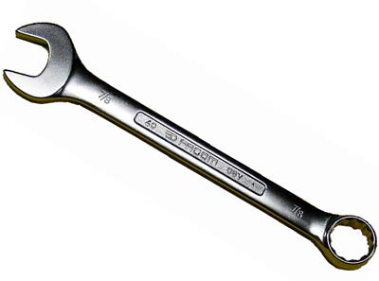
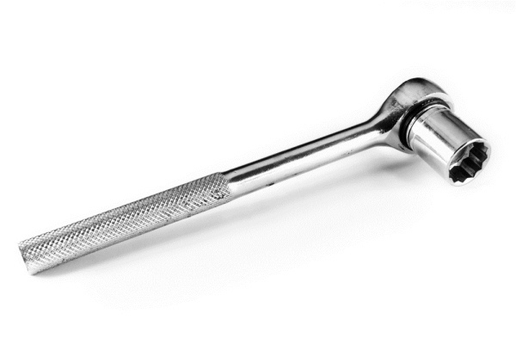
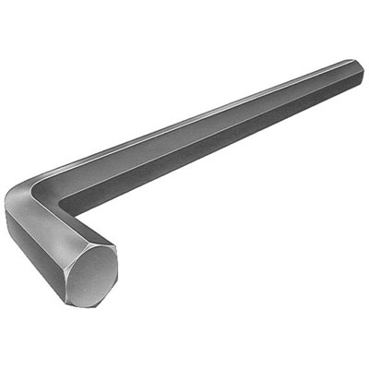
Hand Tools - Deeksha, Gautham, Nidhin
Wrenches → Gautham
Open End Wrench - a wrench with two open ends
Combination Wrench - a wrench with both open and closed ends
Ratchet - a wrench with ratchet movement, used with a socket
Allen Wrench – a tool used to tighten/loosen allen screws

Slide 15
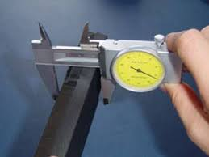
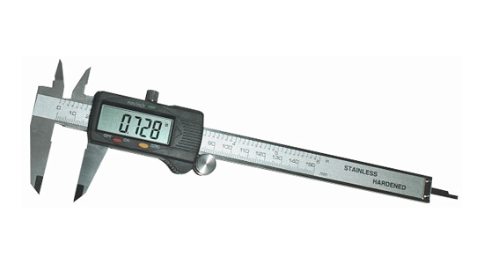
Hand Tools (cont.)
Calipers → Gautham
Precise measuring tool(and very expensive) -- handle with care
Should never be fully closed
Always store in box when not being used

Slide 16
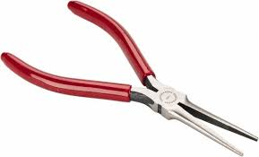
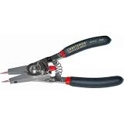
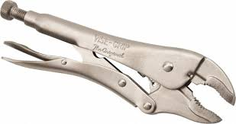
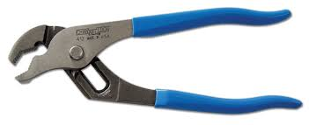
Hand Tools (Cont..)
Pliers: → Deeksha
Needle Nose: pointed pliers used for wiring
Retaining Ring: used for spreading retaining rings
Channel Lock: Adjustable grip pliers, used to hold onto material
Vice Grip: Locking pliers used for firm grip on material
Needle Nose
Retaining Ring
Channel Lock
Vice Grip

Slide 17
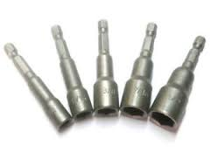
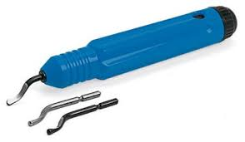
Hand Tools (Cont..)
Drill Bit Adapters: → Deeksha
Used for socketing socket head screws.
Can be used to screw in wood screws as well.
Deburring Tool: → Deeksha
Align thumb in a straight line with the tool.
Apply slight pressure and slide tool to thumb.

Slide 18
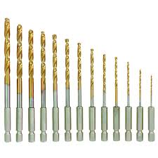
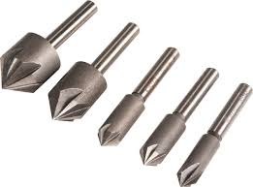
Hand Tools (Cont..)
Drill Bits: → Deeksha
Insert into drill chuck securely.
Return immediately after use.
Counter sinks: → Deeksha
Used to deburr the insides of holes.
Insert into hand drill or drill press securely.

Slide 19
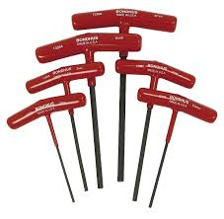
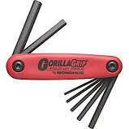
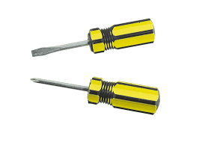
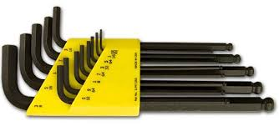
Hand Tools (Cont..)
Allen Keys: → Deeksha
Used for tightening and loosening socket head screws
T-Handle, L-sets, and Flipping sets
Imperial, Metric, and Torx
Screwdrivers: → Deeksha
Used to tighten and loosen screws
Phillips and Flathead

Slide 20
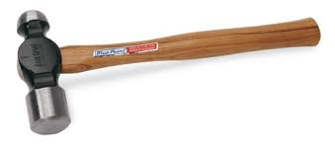
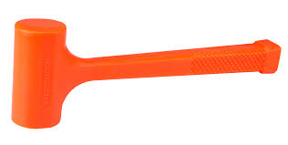
Hand Tools (Cont..)
Hammers → Gautham
Ball-Peen Hammer - a hammer with a round point on one end and a flat head on the other end
Dead Blow - a light soft faced hammer that does not dent objects when struck or rebond when hit

Slide 21
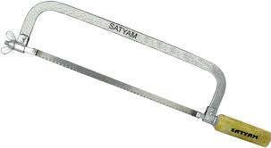
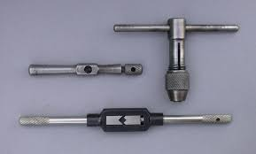
Hand Tools (Cont..)
Hacksaws → Gautham
Only cut in one direction, do not put pressure on the back stroke
Switch out worn out blades by loosening the wing nut
Taps → Gautham
Drill correct size tap hole
Insert correct tap into tap holder
Apply cutting oil and gentle turn the tap holder till the desired depth

Slide 22
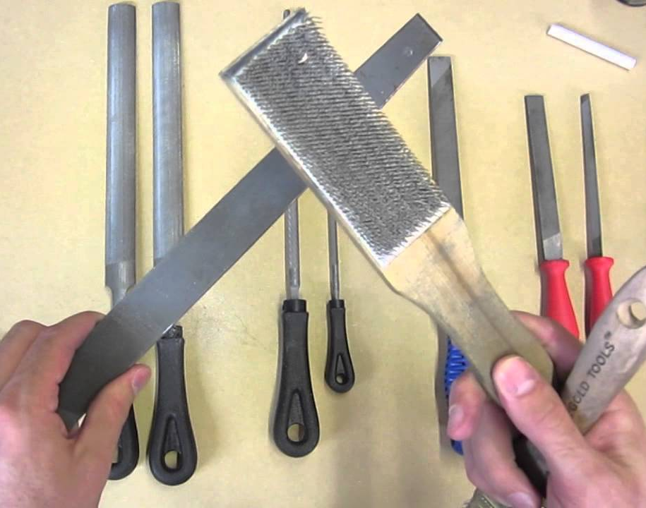
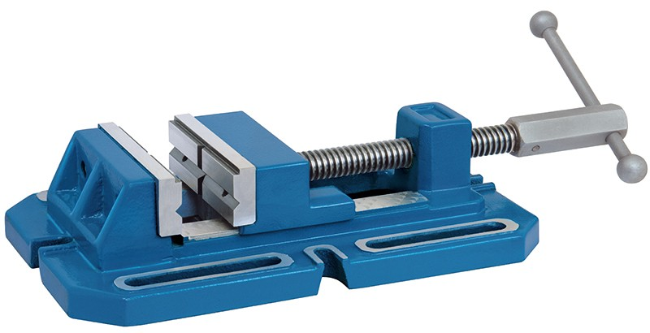
Hand Tools (Cont.)
Files → Gautham
Work only in one direction
When file channels are filled up, use file card to clean them up
Vise → Gautham
Use to securely hold a part before any manipulation

Slide 23
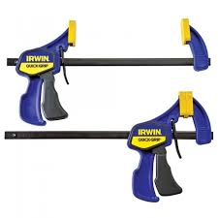
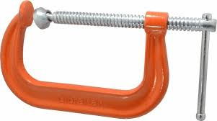
Hand Tools (Cont..)
Clamps → Nidhin
One of an engineer’s best friends!
You will probably be clamping everything before doing anything
Different clamps for securing different materials in positions
Return clamps after use

Slide 24
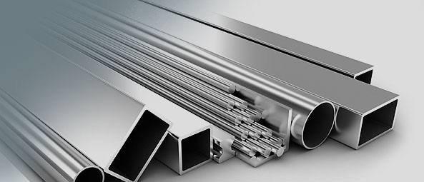
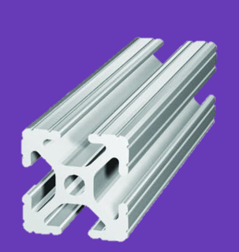
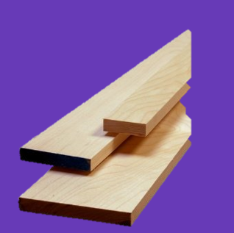
Materials - Rithin
6061 Aluminium
Main material choice for Chassis, Manipulator
2x1, 1x1, channel, L varieties
7075 Aluminium
Shafts
Hex and Round with ½” and ⅜” diameters
Plate
Aluminum in varying thicknesses
6061 is hard to bend(tempered), 3003 and 5052 bend easily-can be used for encoder mounts/brackets
Wood
Easy to prototype with
Used for field elements
Bosch
Grooved aluminum stock
Can be combined with gussets for easy prototyping

Slide 25
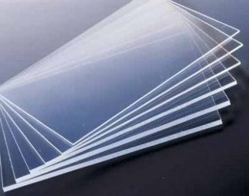
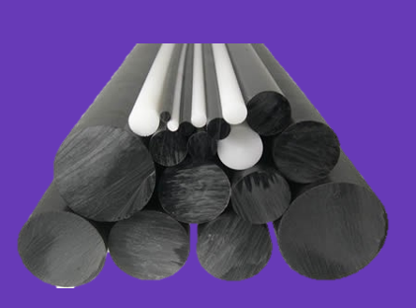
Materials (Cont..) - Rithin
Polycarb
Plastic in varying thicknesses
Easy to bend and maintains rigidity
Polycord
Plastic wire
Can used for driving intakes and pulleys
Delrin
Hard Plastic
Used for wheel blocks, sliders and chain tensioners

Slide 26
Prototyping Process - Rithin
CAD drawings
Navigate assembly, find part, make drawing, fabricate
Technical Drawings
Always make a technical drawing of prior to fabrication.
Assembly and fabrication
Follow directions, either from a veteran or documented manual
Keep parts organized and if work is suspended, make sure parts are put in a place to be found
For fabrication use tape/sharpie to label each part according to part number or function
Ask Questions
Misc.
Criss Cross Tightening
Use spacers to prevent walls from collapsing
If a screw is stripping stop and change bit or allen key

Slide 27
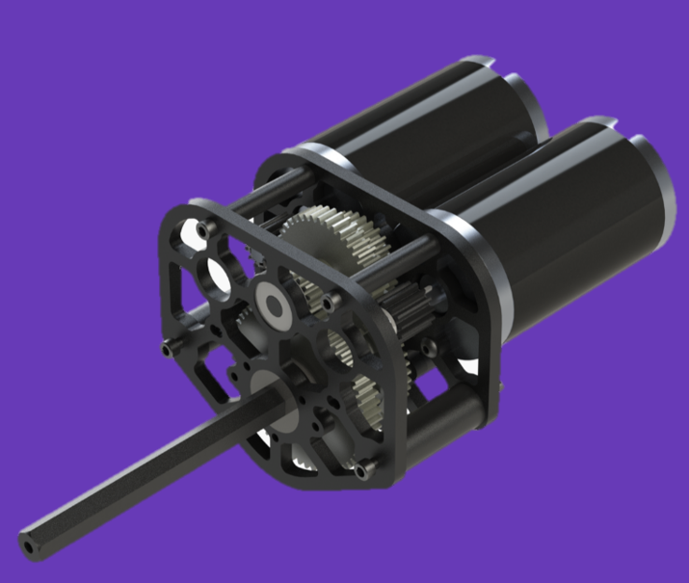

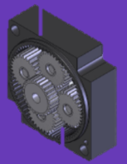


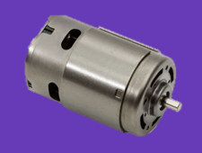
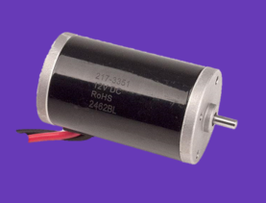
Basic Mechanical Ideas (Cont..) - Rithin
 | VersaPlanetary Gearbox Six different planetary stages provide dozens of gearing options from 3:1 to 100:1 Adapts to any FRC spec motor
WCP-DS
Options for two or three CIM-style motor inputs
Used for Drivetrain
CIMS/MINI CIMS
Used for Drivetrain
Highest Stall Current
RS-775 pro
Power of a CIM in a smaller Package
Air Cooled
Used for intakes, shooter wheels
Stall current is lower than a CIM
BAG
Medium power applications
Stall Current is higher than RS775pro, but less than a CIM

Slide 28
More Advanced Mechanical Ideas - Rithin
Prefabricated Gearboxes: VPs and WCD (Assembly)
Prototyping
Manipulator design
Drivetrain Chassis
Pneumatics(joint with electrical)

Slide 29
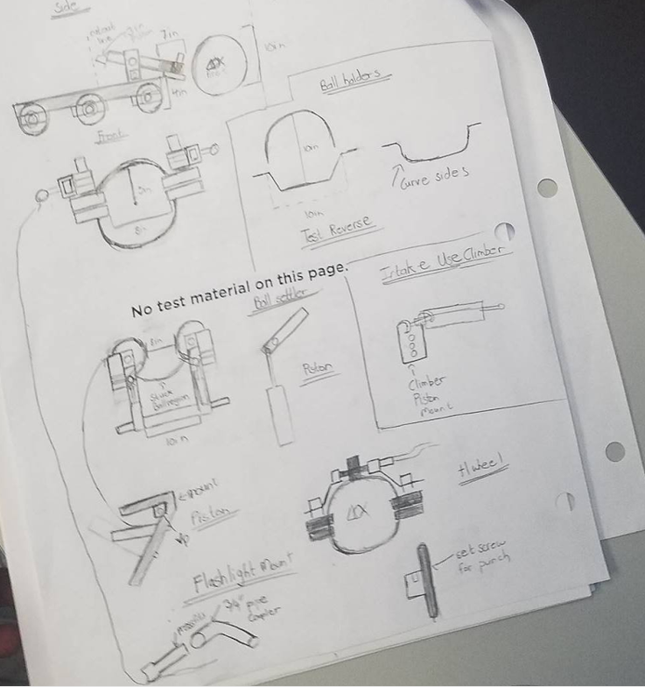
Creating Accurate Sketches and Drawings - Rithin
Reasonability
reasonable idea of limitations, due to both FRC as well as our resources.
Sketches and Drawings for prototyping
Iterative Sketching process
Initial sketch to convey ideas to others
Progressive sketch, neater, more components are laid out
No measurements yet, what’s the point
Play around and decide on materials and parts needed
Create a final well drawn sketch with measurements and parts needed

Slide 30



Resources - Deeksha
Purchases and Orders:
Vexpro.com → versa planetary materials
Andymark.com → premade units
West Coast Drive
SDP SI → custom pulleys and belt orders
Alan Steel → main stock purchase
Information and Inspiration:
Chief Delphi
FRC Blog and CAD
Solidworks

Slide 31

Thanks for watching!

